Slide 1

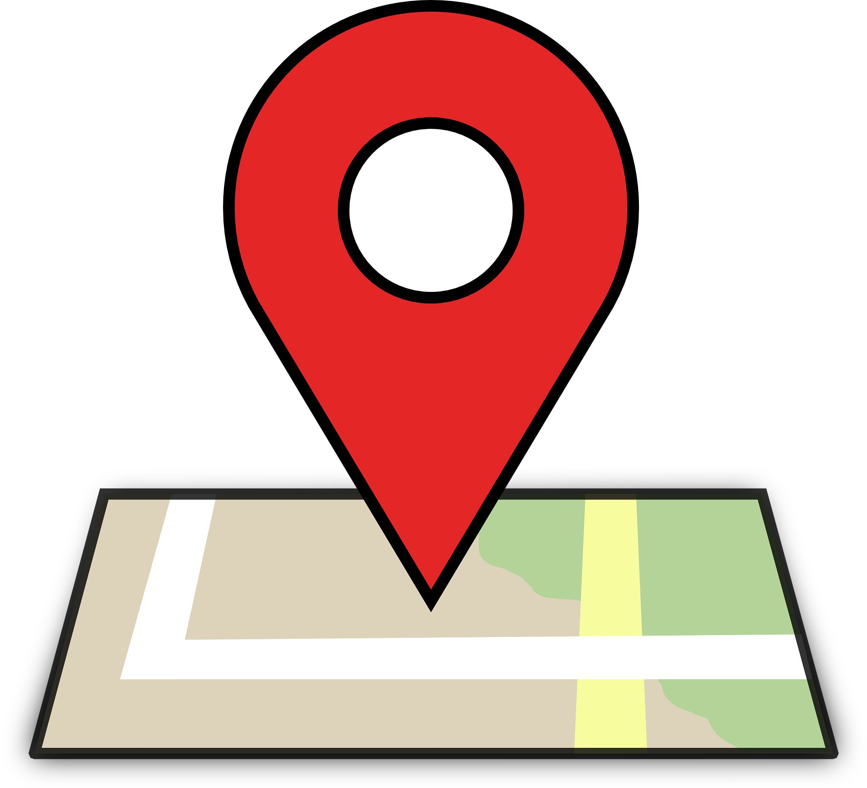
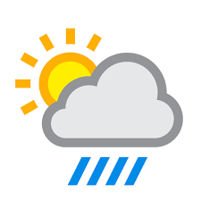

Node-RED
Get the weather condition of the location
Get the garden location
Send weather data to the NodeMCU
Using MQTT In node, we get the garden location from the MQTT broker.
We use https://test.mosquitto.org/ as our MQTT broker.
To get weather information at the given location, we use the OpenWeatherMap node.
https://openweathermap.org/ Provides real-time weather details to the OpenWeatheMap node.
Using the MQTT Out node, we send the weather details of the given location to the MQTT broker.
NodeMCU then retrieves the weather details from the MQTT broker.

